Slide 1
Problem D Bristol Open Data Analysis
Group 33

Slide 2



Overall and Purpose [30 sec]
The increase in the adoption of electric vehicles in Bristol is positively correlated with the improvement in the air quality of Bristol
The impact on traffic due to Covid-19 lockdowns can be used as a reliable proxy for calculating the potential impact of EV adoption and a clean air zone.
The quality of life in Bristol is positively impacted by good air quality, leading to an overall improvement in citizens' quality of life.

Slide 3
Data source [30 sec]
Data name | Source | Detail
Air quality and pollution
Air quality data | Open Data Bristol | NOx, NO2, Air Quality, Air Pollution, Pollution, Traffic, PM10, PM2.5, Date
Transportation and vehicle
Licensed ultra-low emission vehicles (Car registration) Mobility data COVID-19 | GOV.UK GOV.UK | fuel type, keepership (private and company), amount of vehicles Percent change from baseline in transit stations
Socioeconomic
Quality of Life | Open Data Bristol | Year, Indicators, Theme, Statistics, Polarity. (Annual survey results from Bristol residents from 2015 to 2021 on topics such as health, economics, and environment.)

Slide 4
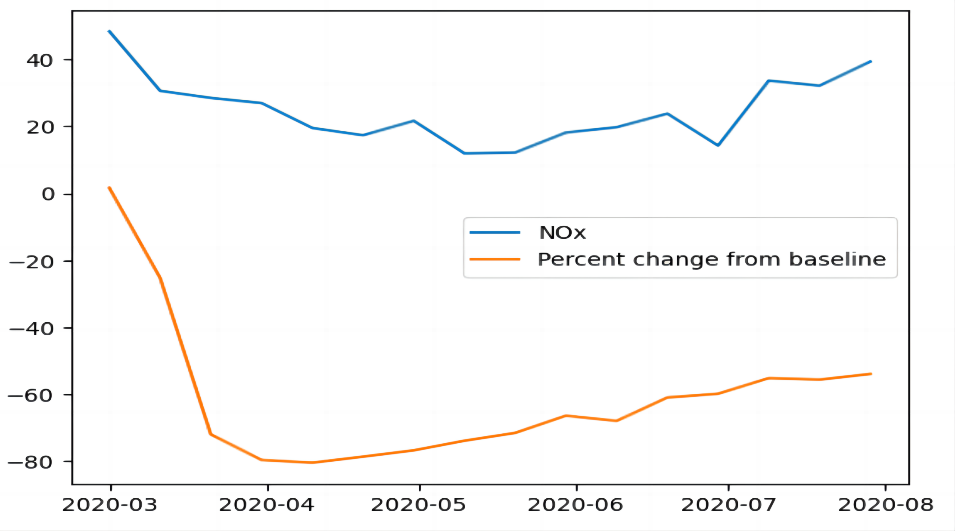
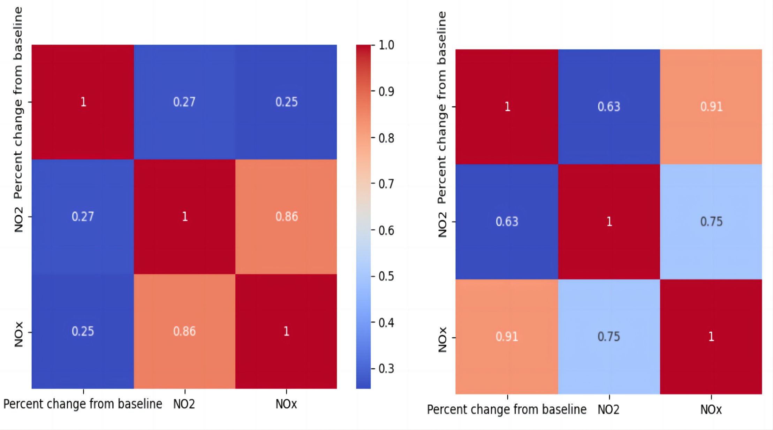
Explore The Impact of Changes in Transportation Modes During The Lockdown on Key Air Pollution
The changes in NOx and the changes in traffic patterns are very similar, falling and rising at the same time almost concurrently.
The relationship between the two is very loose when the policy is relaxed, with data of only about 0.2. However, when the policy is implemented, the relationship between the two is as high as 0.9.
Notes:
I have added animations to my images because the text is not visible if the images are too small

Slide 5
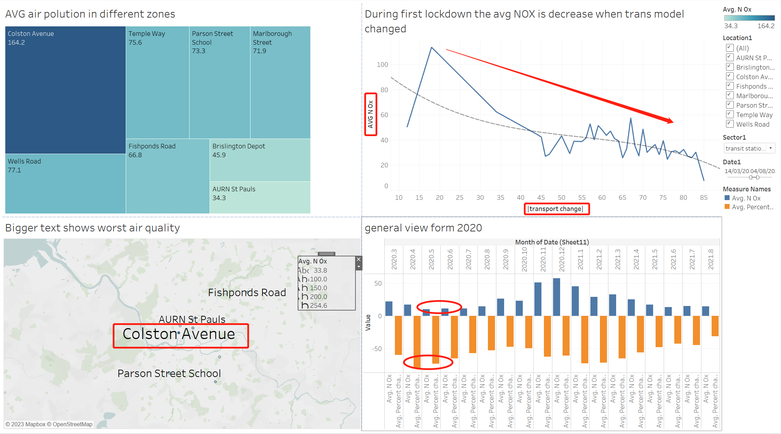
Specific Implementation Plans for Similar Policies
the pollution figure is highest around Colston Avenue. Therefore, the money charged for petrol cars around Colston Avenue could be increased to limit travel.
It can be observed that the decreasing trend is most significant when the rate of change in transport is maintained at around 60%.

Slide 6
Further improvement
Considering Other Cities' Experience:
Future studies should include more metropolitan traffic locations
And conduct randomized trials to evaluate the effect of traffic limits on air quality using data from cities like Birmingham.
Analyze the Correlation Between Different Restrictions:
Analyzing the correlation between various periods and restrictions can help identify the most effective policy measures to improve air quality.
Analysis of the Cost of Implementing the Policy:
Implementing the Bristol clean air zone policy may impact the city's economy. Analyzing indirect costs, such as revenue loss and maintenance expenses, is crucial for its smooth implementation.

Slide 7
Group member Yining Yuan Xinyang Song Tharathep Chuayrod
THANK YOU FOR YOUR TIME
AND YOUR ADVICE

